Slide 1
Simple Search Engine
Presented by
Sudipto Mondol (232-15-044)
Mehjabin Azad (232-15-807)
Sayed Mustofa Shahrear Rafi (232-15-306)

Slide 2
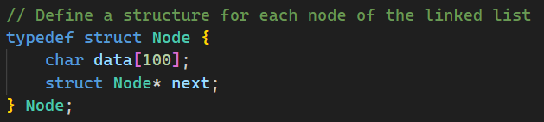
Node Structure.

Slide 3
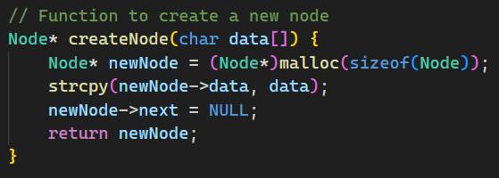
Function to Create Node.

Slide 4
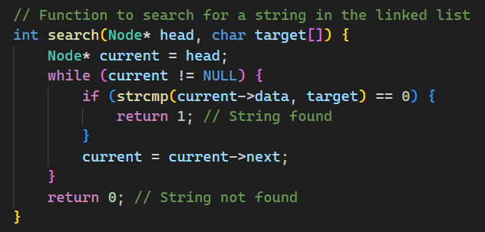
Search Function.

Slide 5
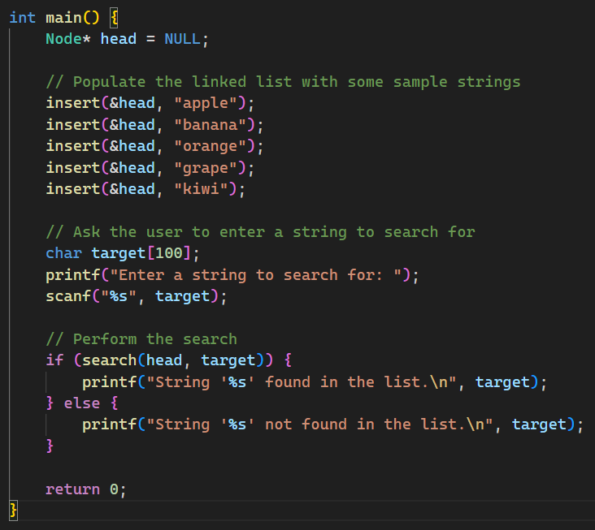
Main
Function.

Slide 6
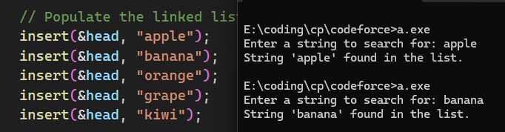
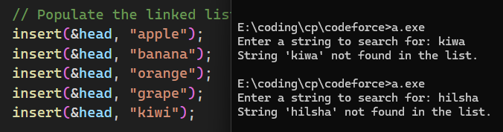
Output sample.
String Found.
String Not Found.

Slide 7

ANY QUESTIONS?

Slide 8
THANK YOU!

